Slide 1

Assignment 1 Hidden Markov Model
Code
https://github.com/Brotherhood94
Alessandro berti
MSC ICT SOLUTIONS ARCHITECT

Slide 2
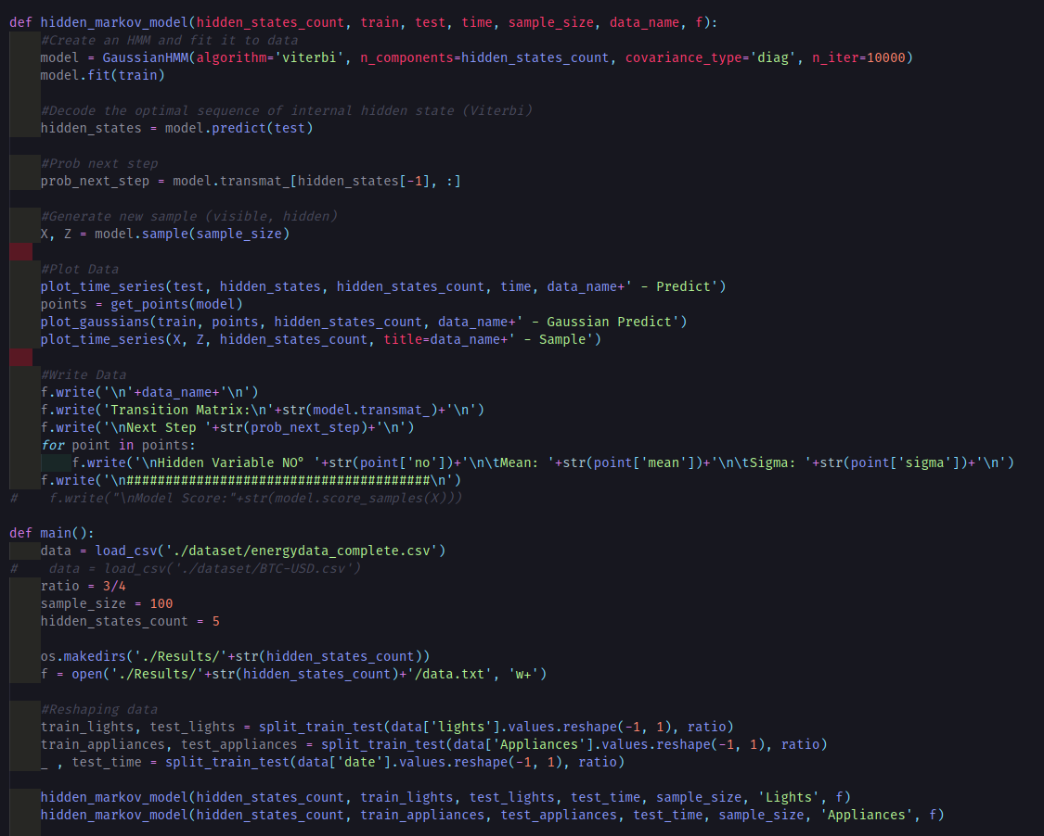
---------
SOME CODE
---------

Slide 3
HIDDEN VARIABLES
2
3
4
0.9
0.90
0.910
0.330
0
0
0
0.003
3
0.030
0.238
0.481
0.024
0.3
0.1
0.04
0.09
0.052
0.01
0.48
0.007
0.080
0.080
0.560
2
1
1
2
1
0.180
0.16
0.130
0.16
0.7
0.530
0.365
0.80
0.36

Slide 4
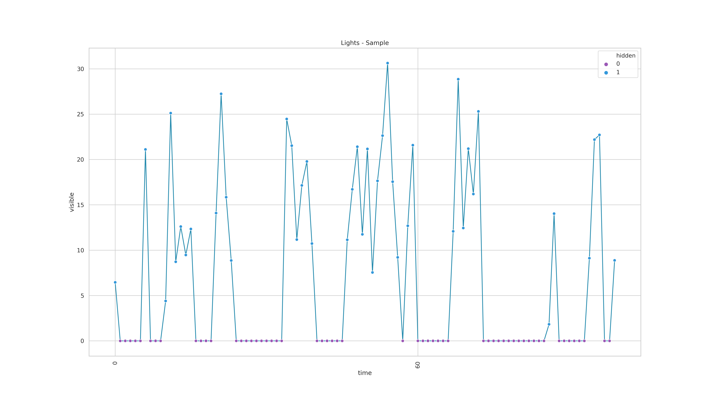
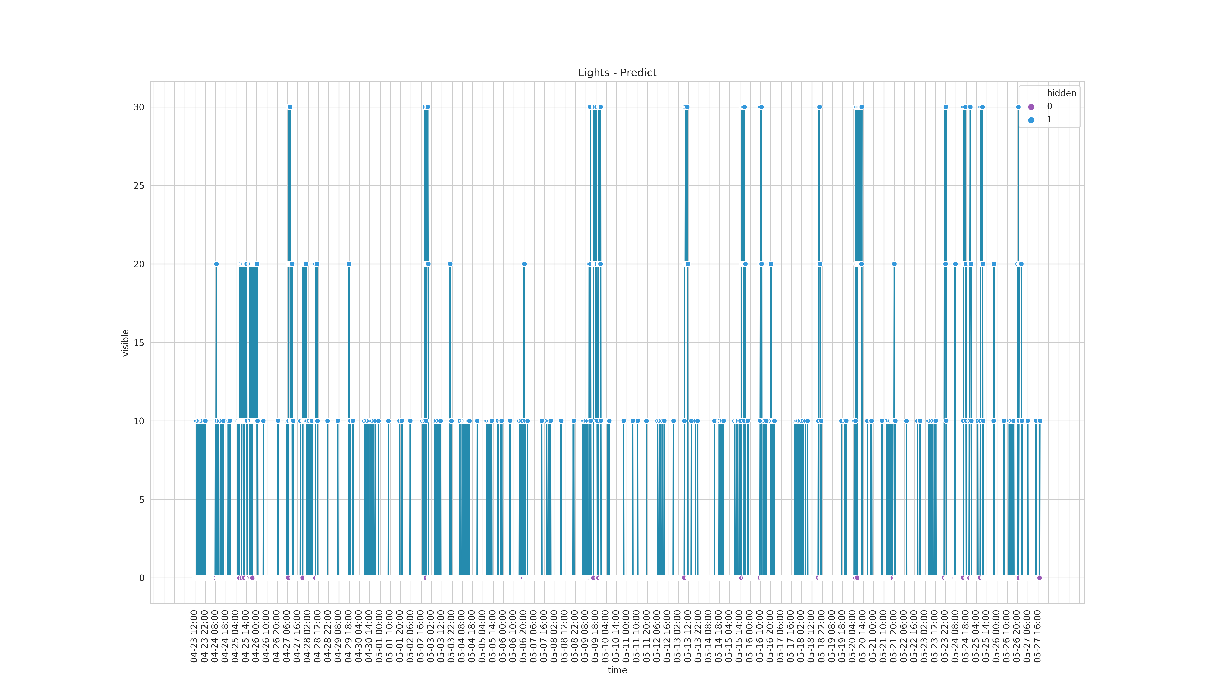

Slide 5

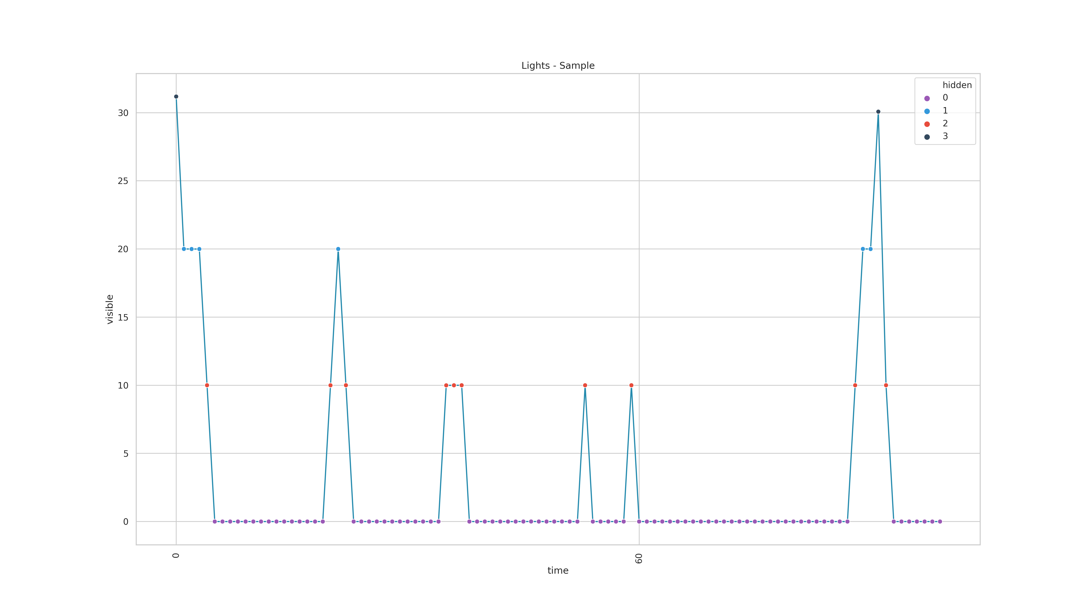

Slide 6
---------
What about Appliances?
---------

Slide 7
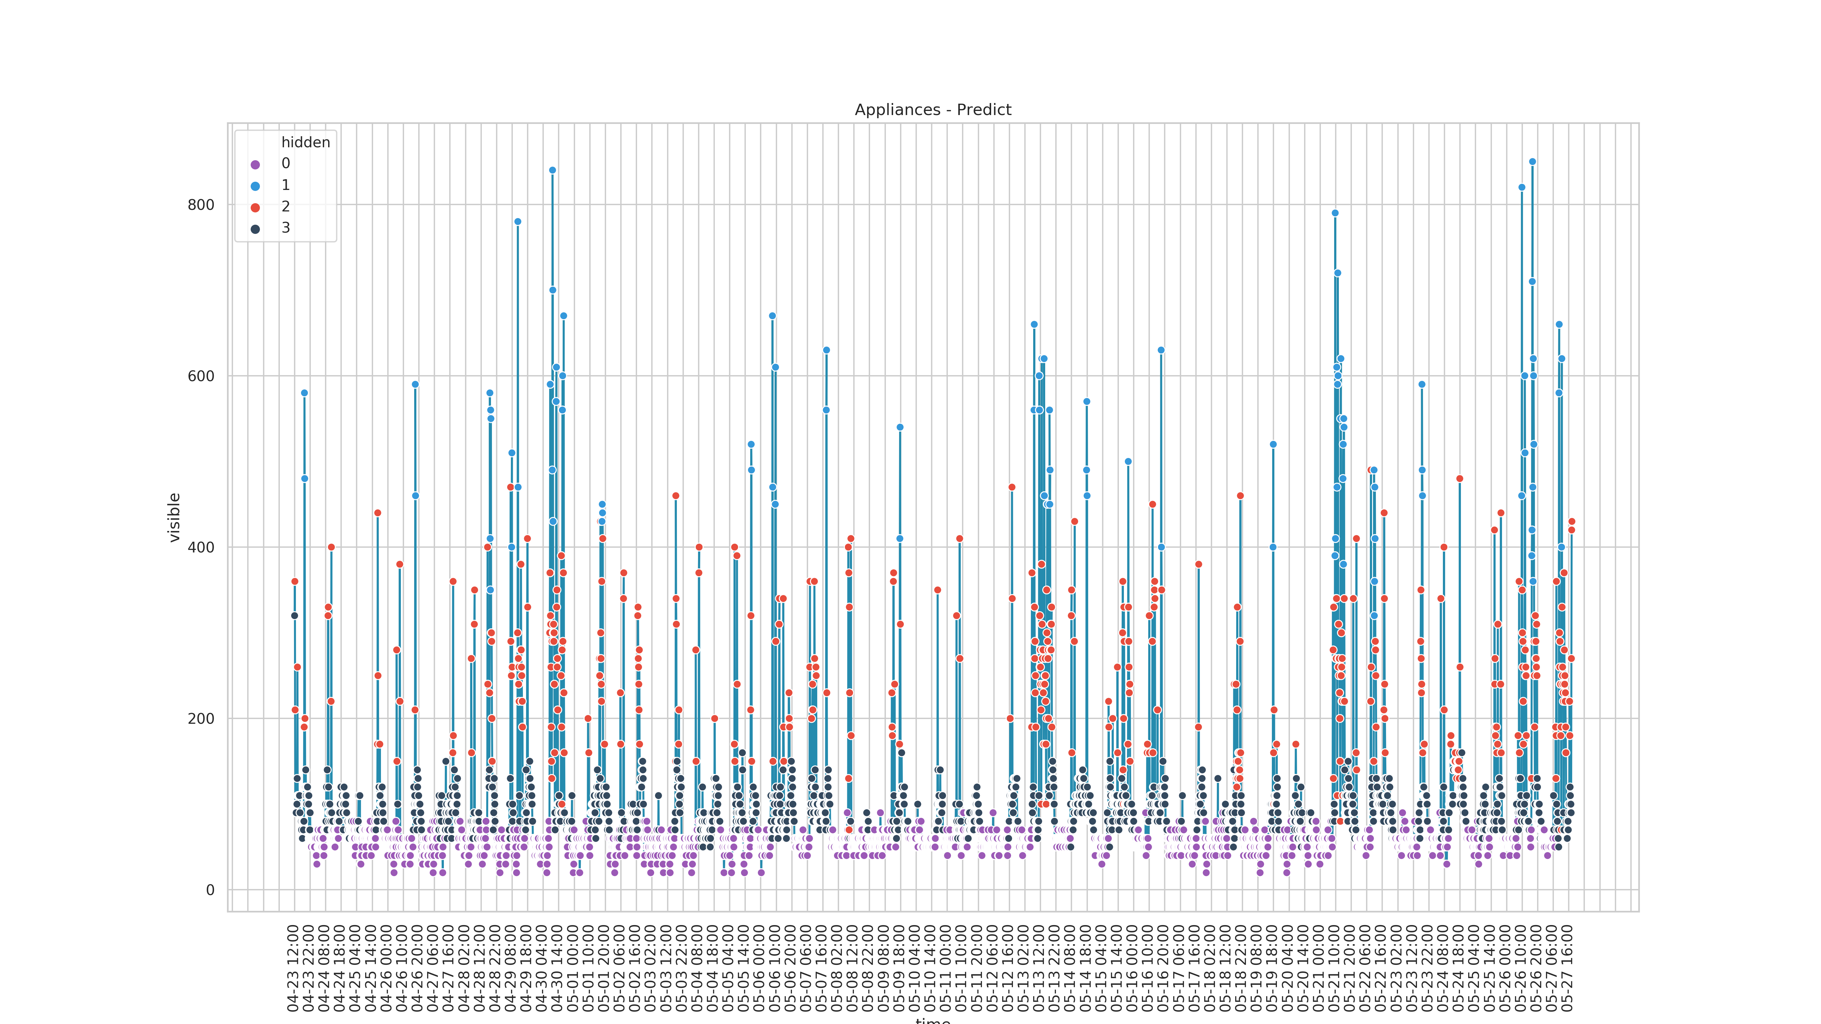
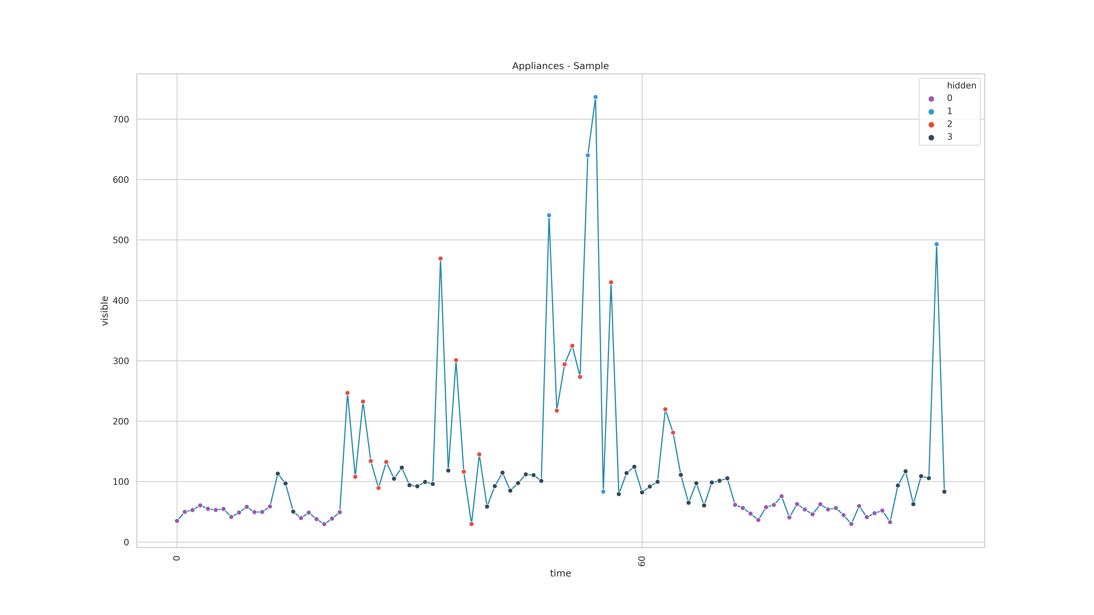

Slide 8
?

Slide 9
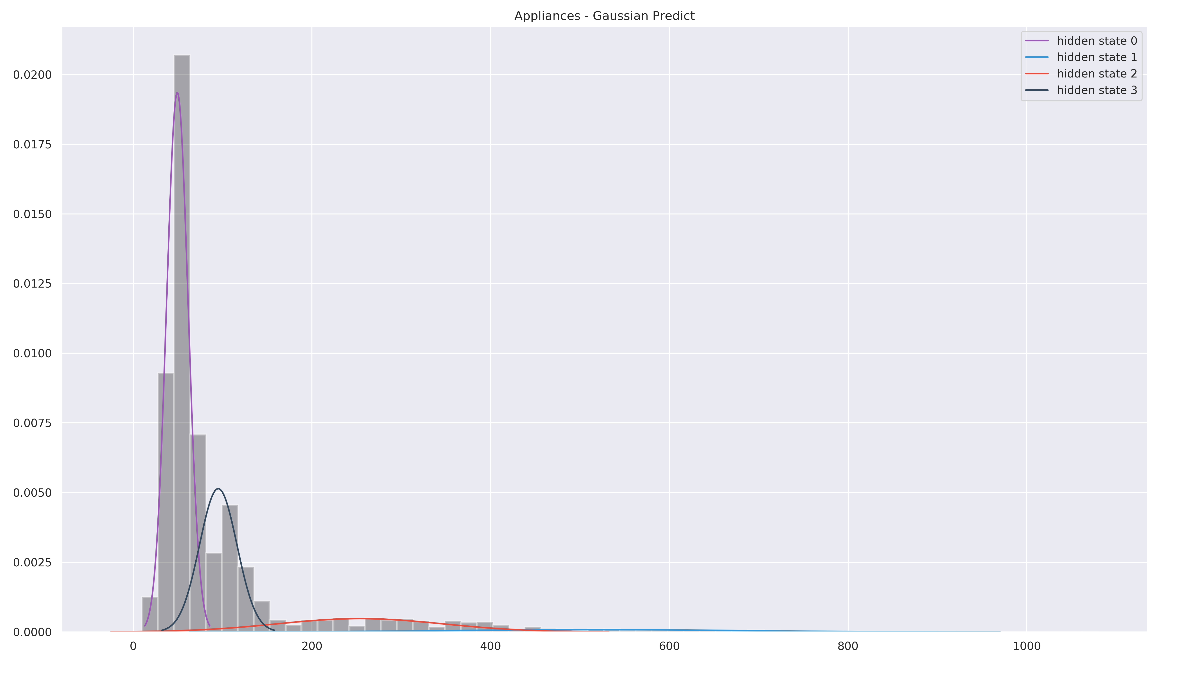
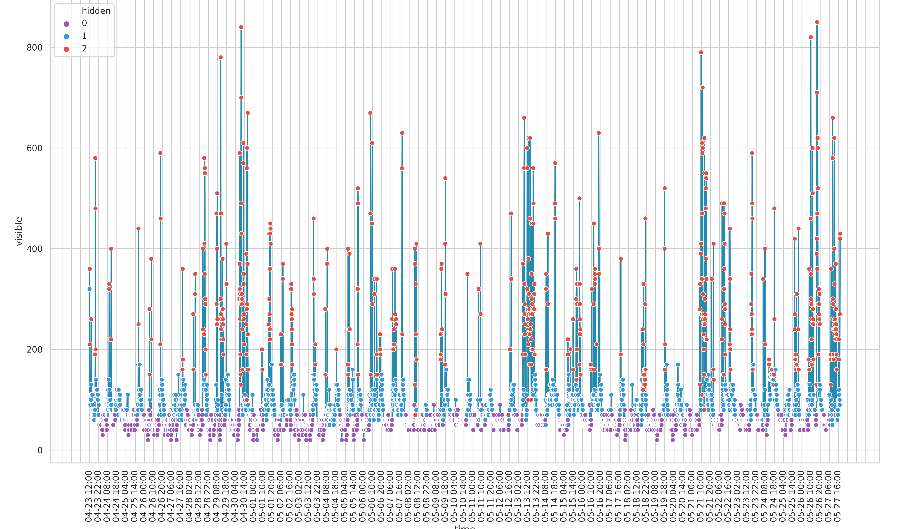
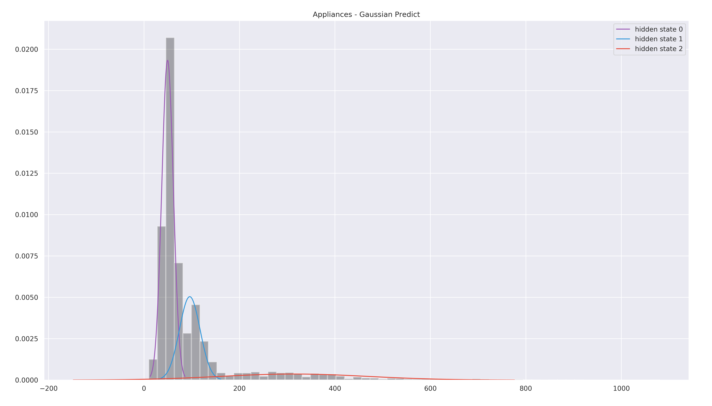

Slide 10
THANKS

